Slide 1
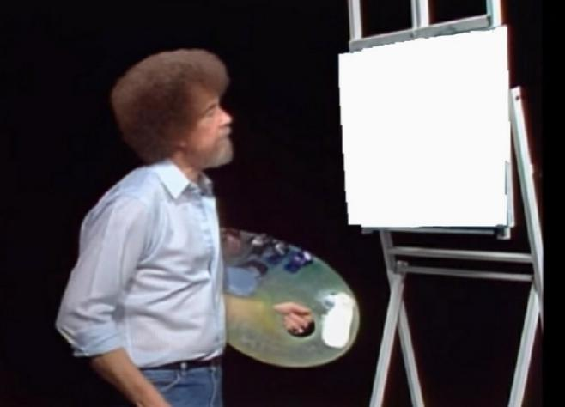
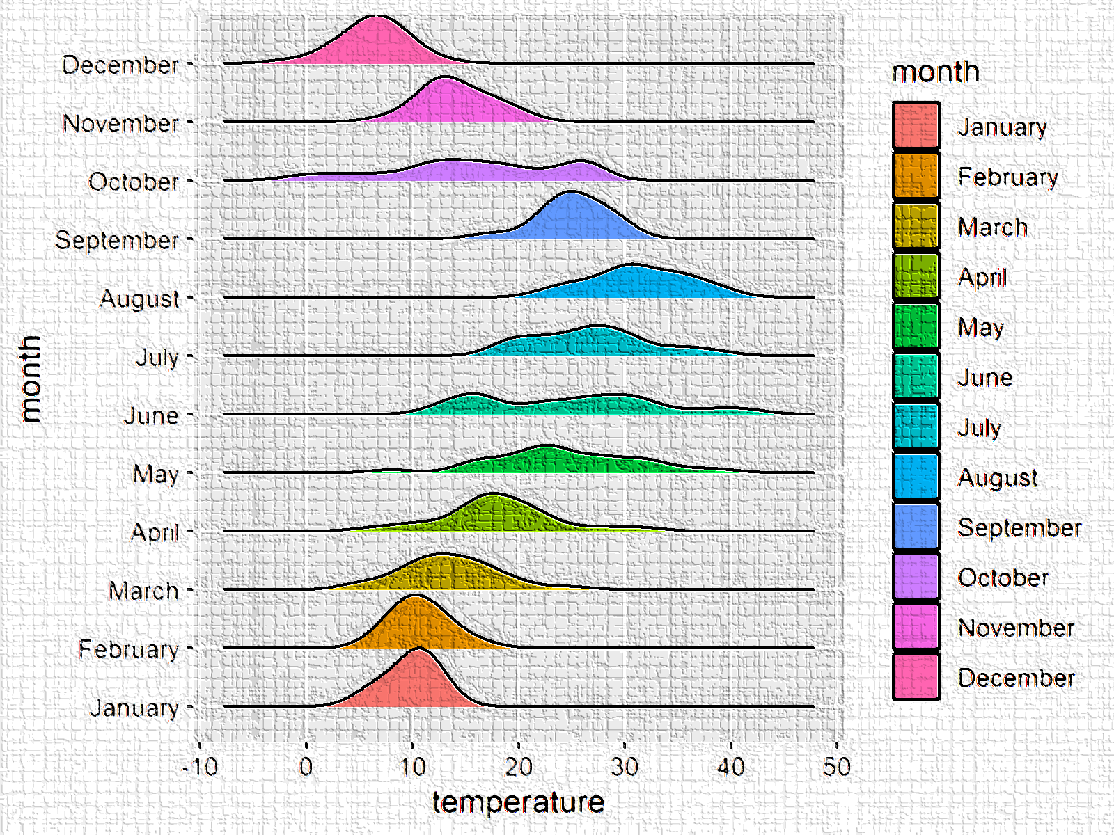
Introduction to ggPlot
Alex Alon
“You too can code almighty graphs.”
"We don't make mistakes,
just happy little typing errors.“
-ggplot

Slide 2
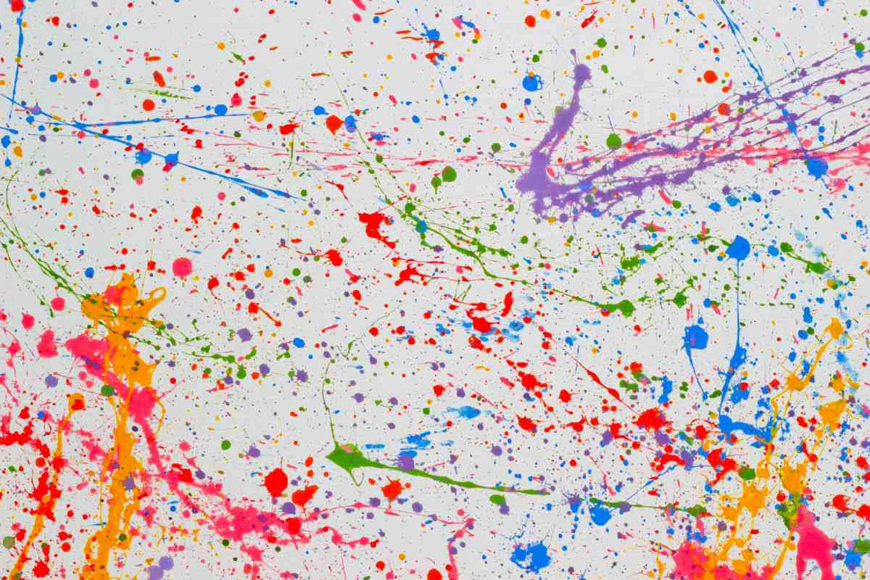
Agenda and Learning Objectives
Monday
Core Components
Wednesday
Building a graph from scratch
Our objective is to:
1. Promote tidy data and clean code
2. Gain familiarity with the components that make up ggPlot graphs
3. Develop confidence and competence in generating accurate and beautiful graphs
4. Foster exploration of ggPlot extensions and available resources

Slide 3
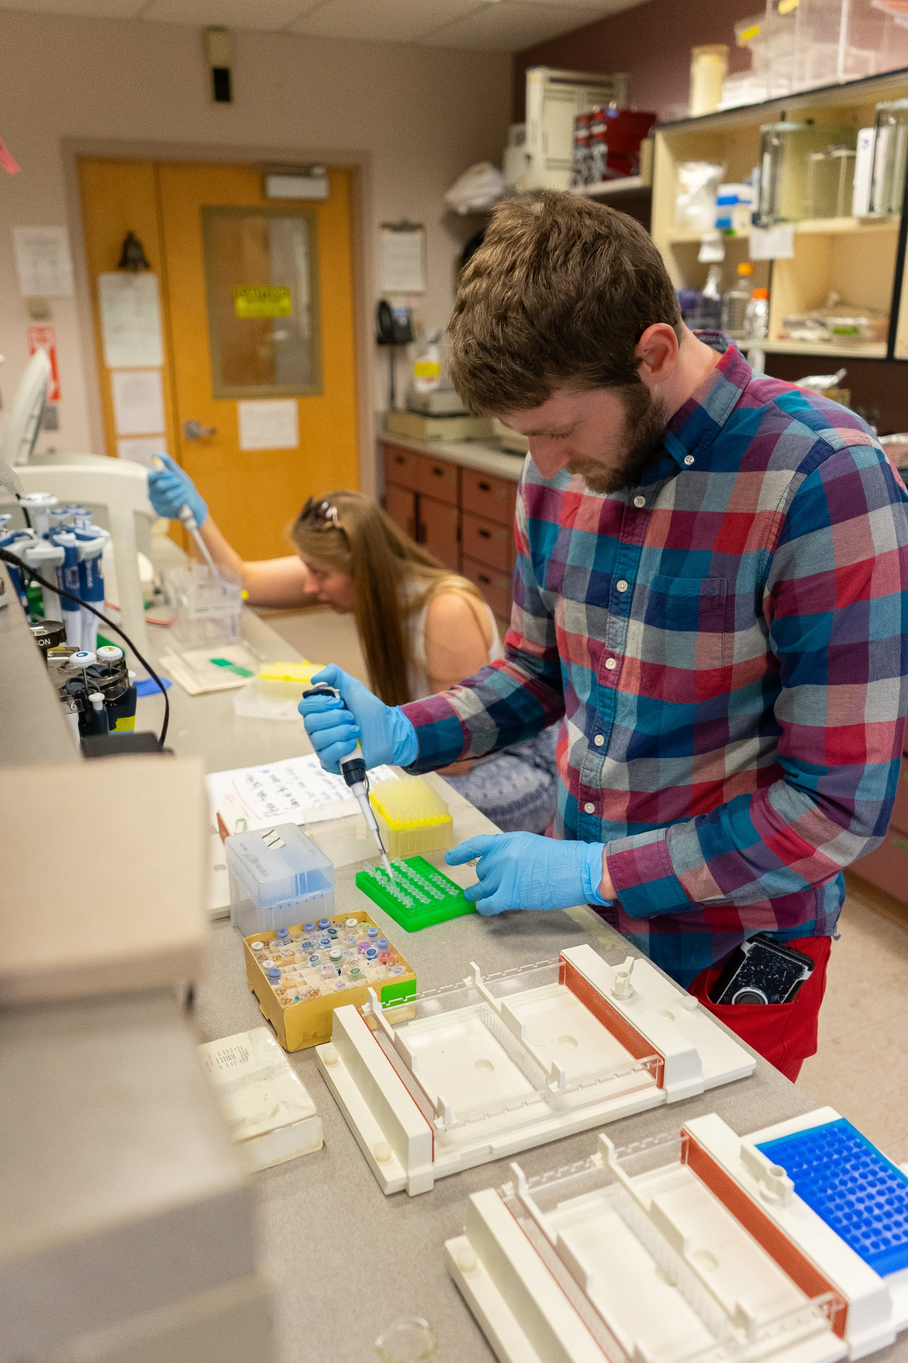
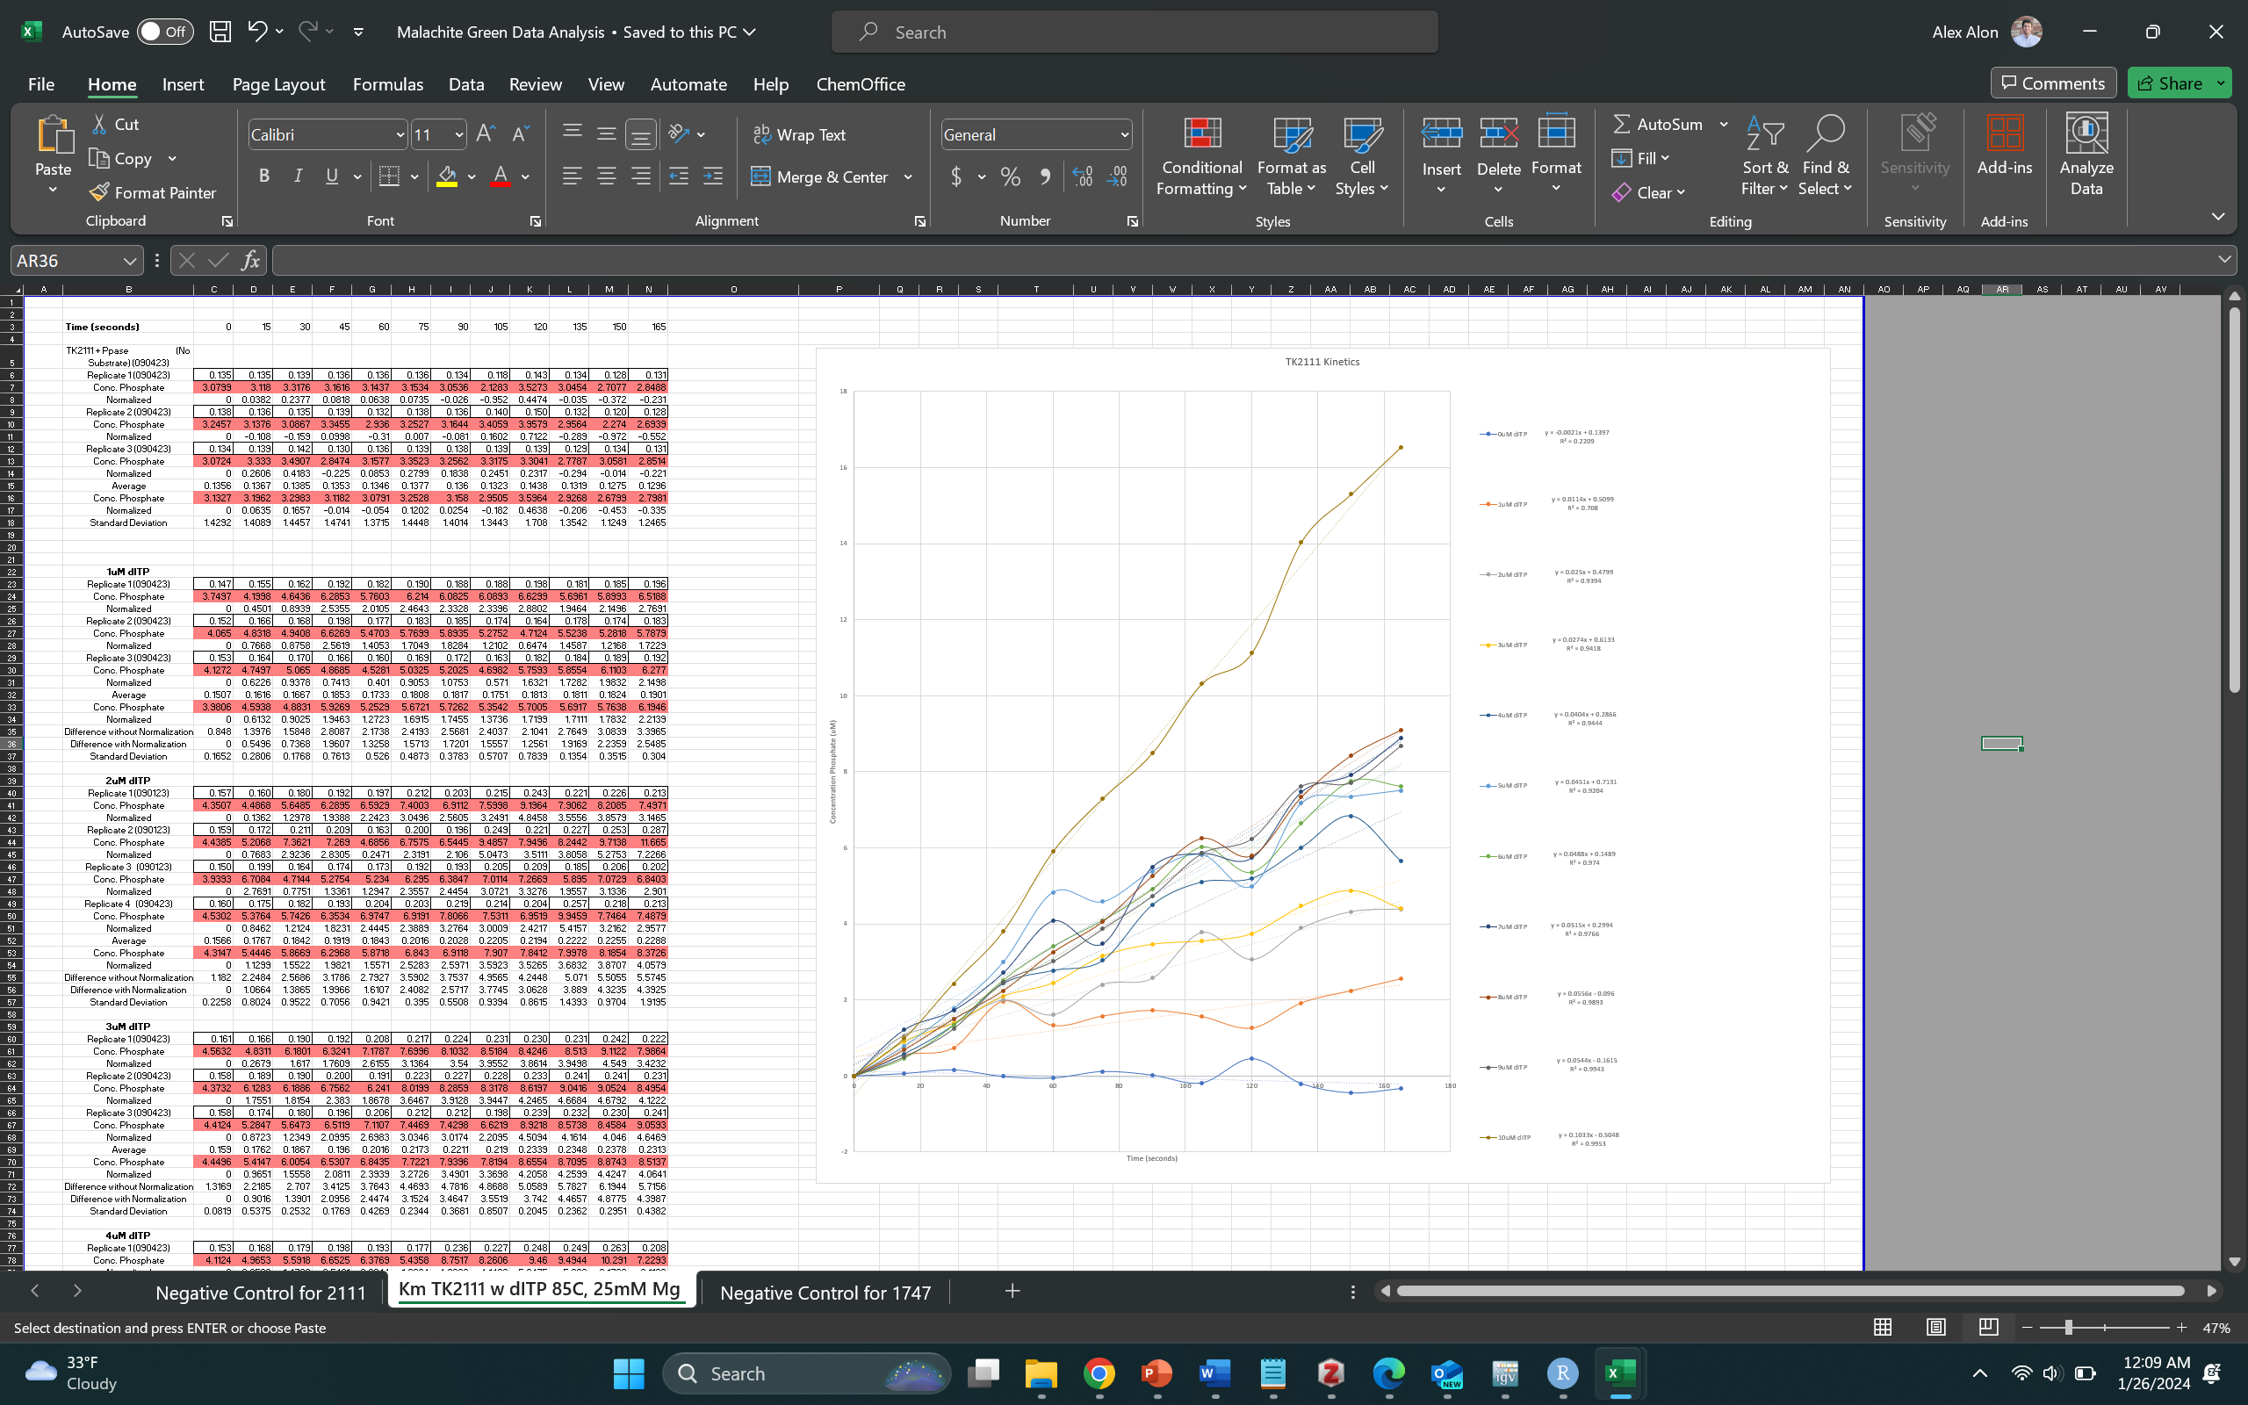

You get the data, now what?
What the hell is even that?!

Slide 4
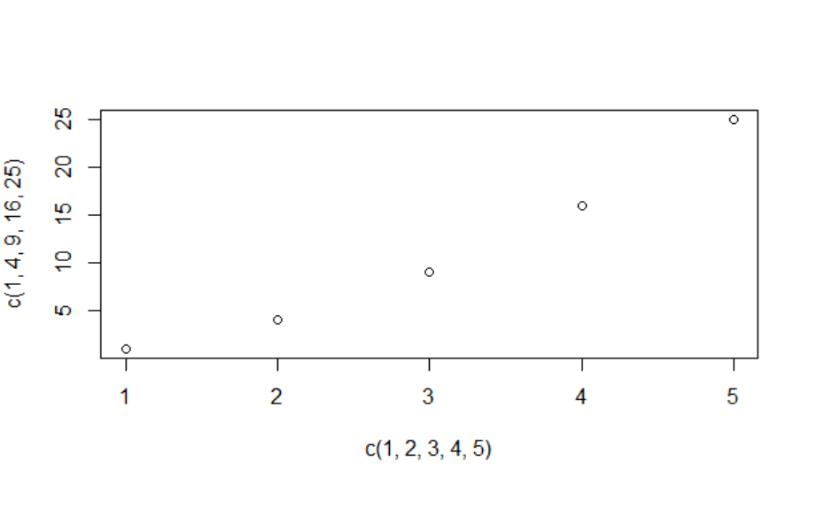
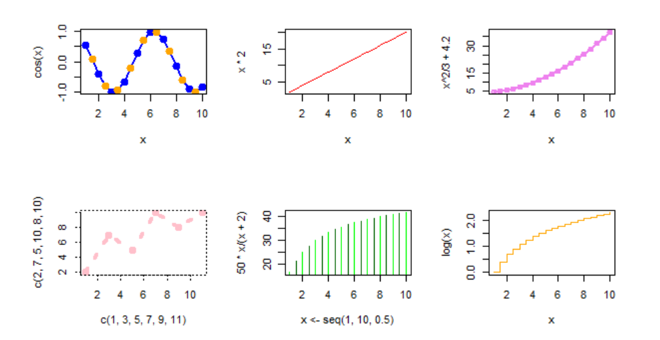
Basic Plotting with R (Code chunk #1)
plot(c(1,2,3,4,5),c(1,4,9,16,25))

Slide 5
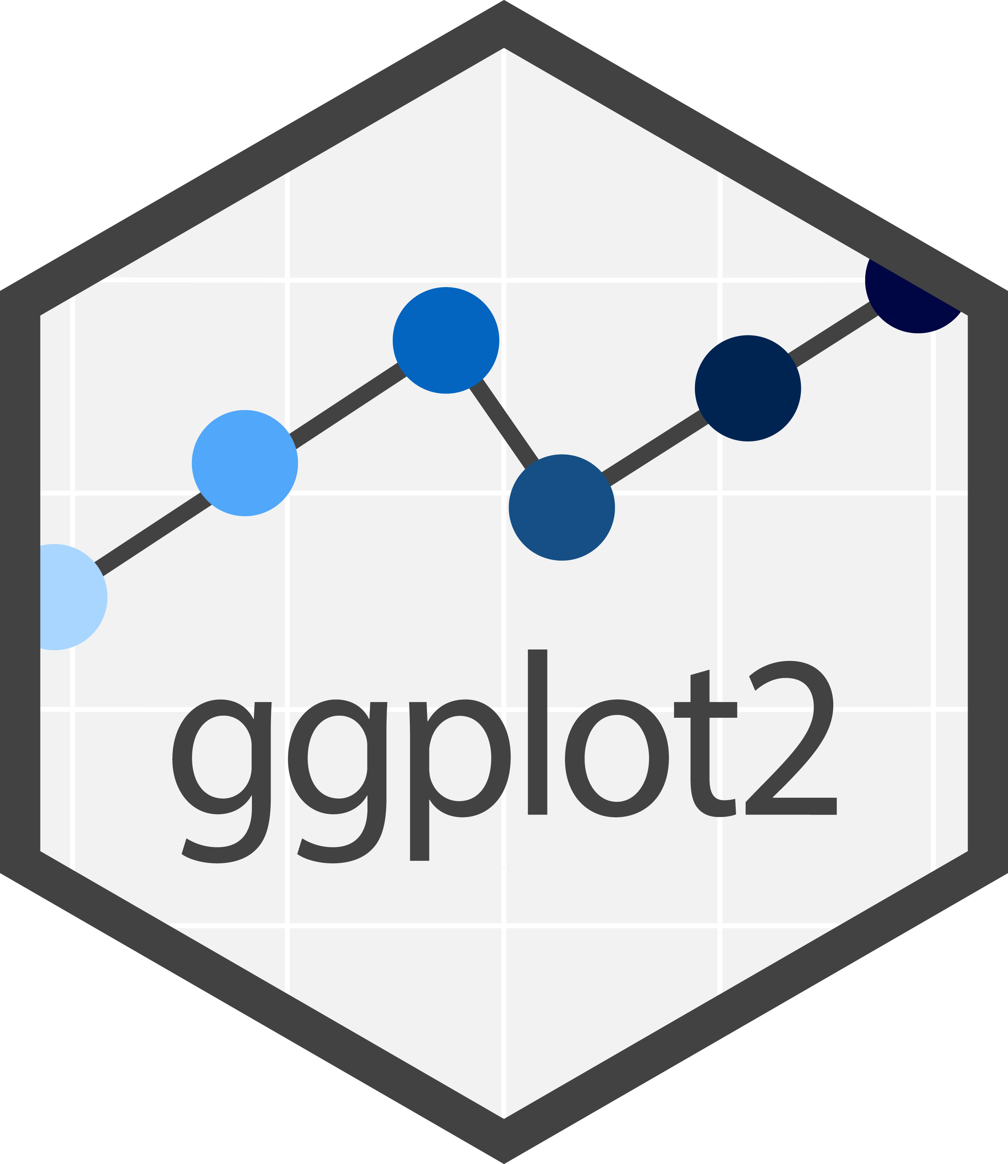
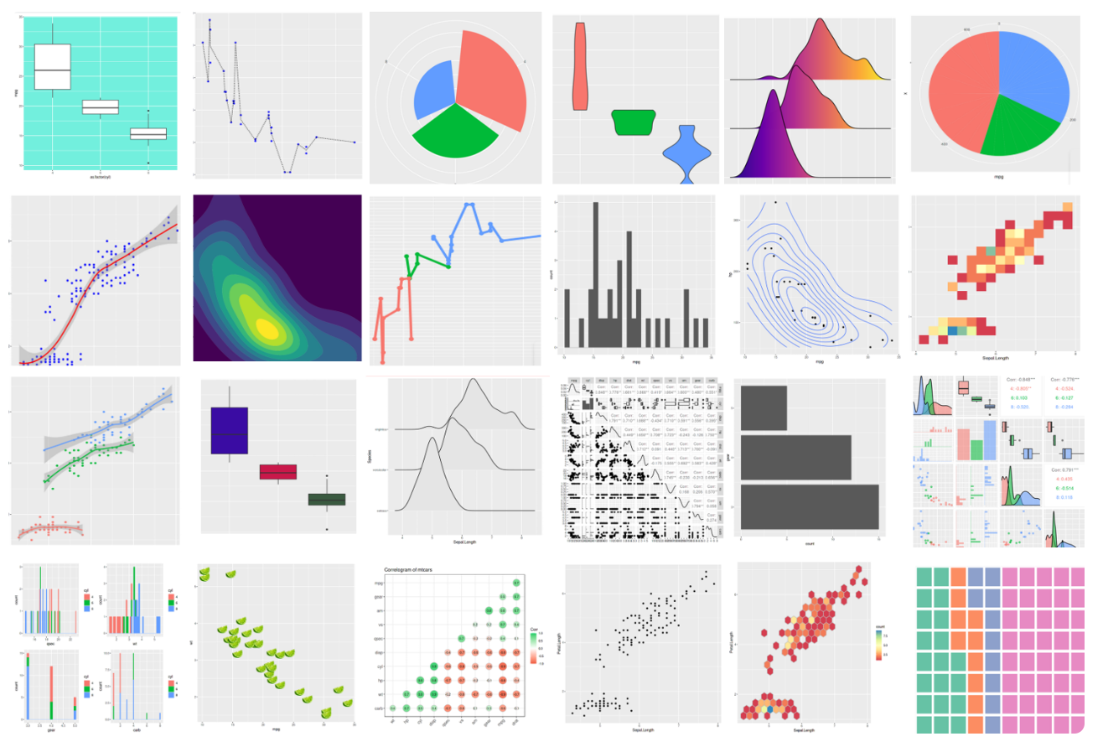
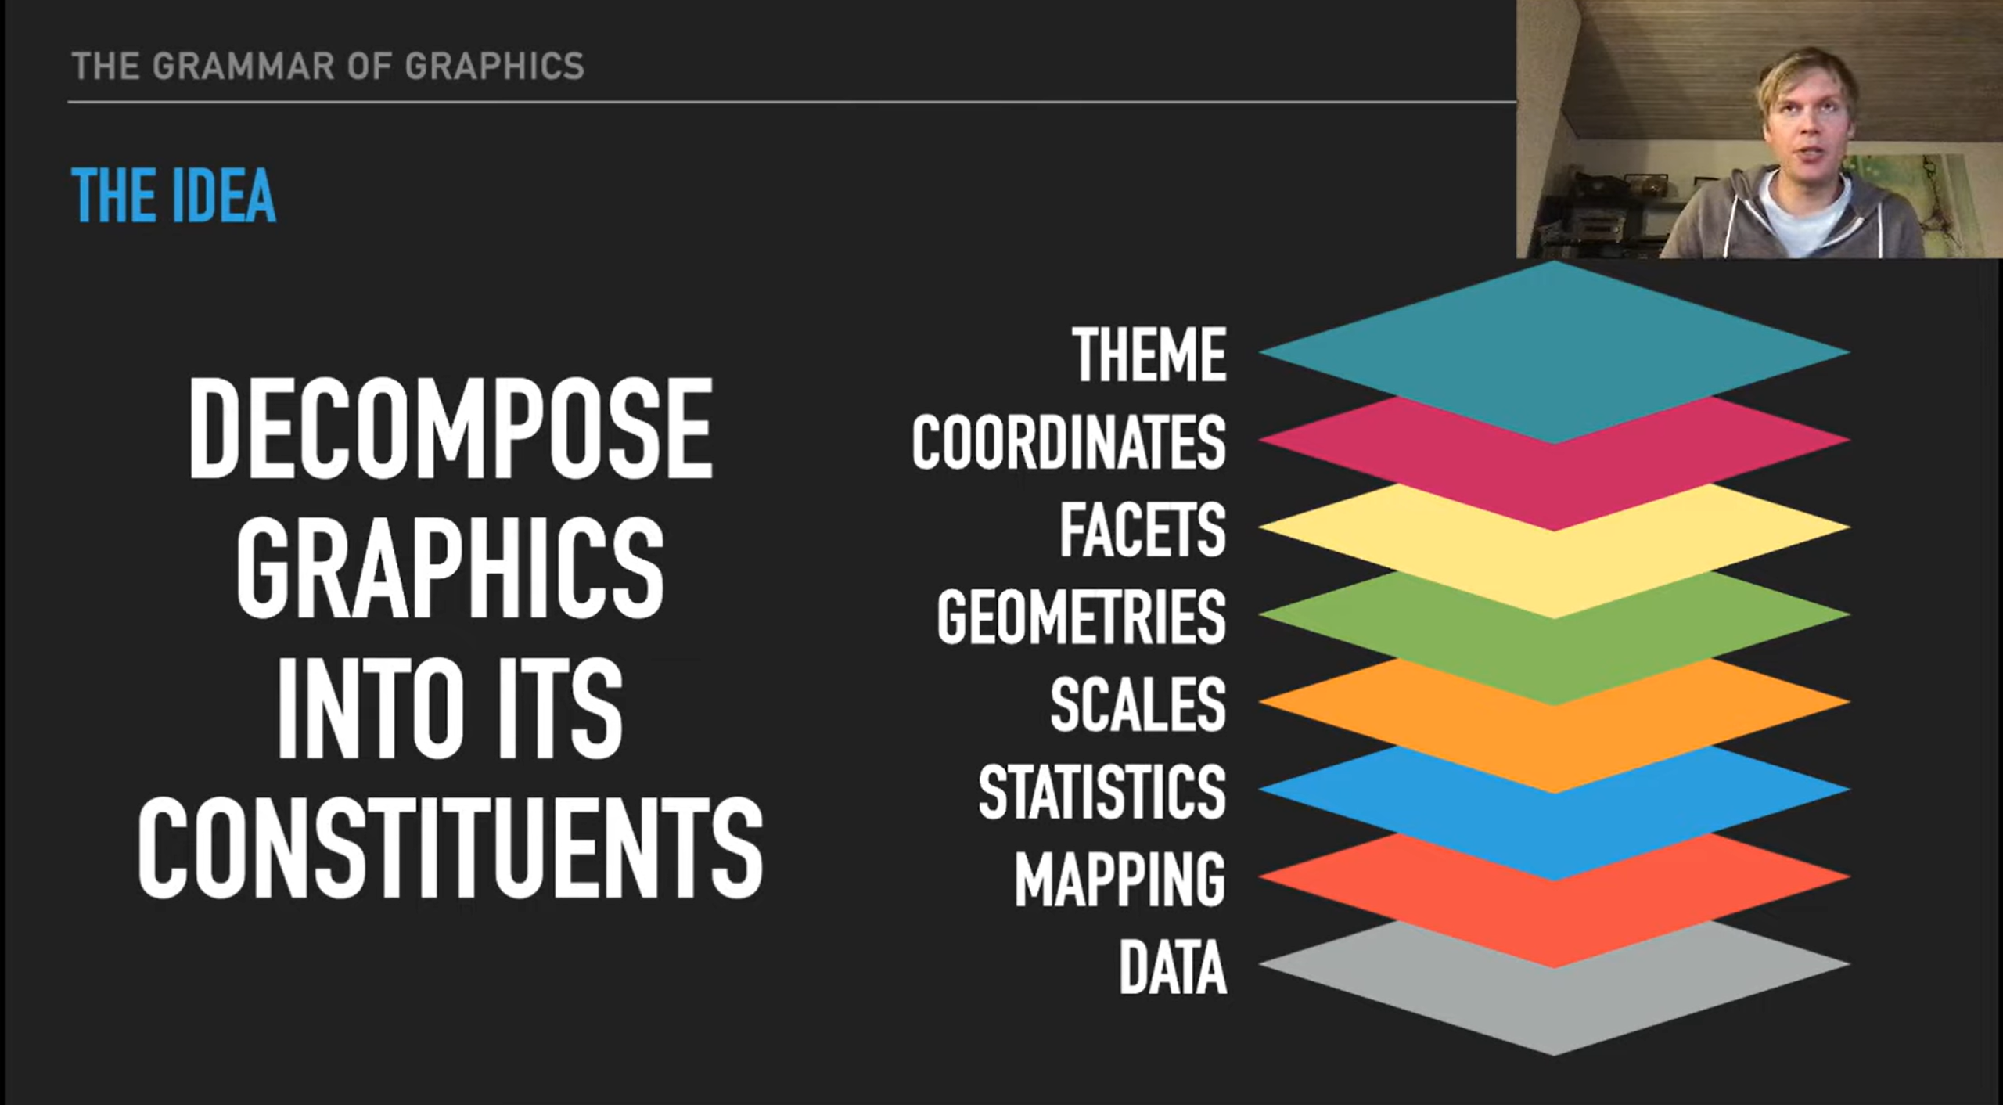

Thomas Lin Pedersen
(AKA The GOAT of ggPlot)
Notes:
Not going to touch statistics because these are often done prior to plotting

Slide 6
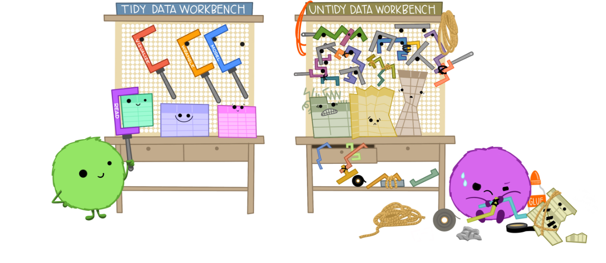
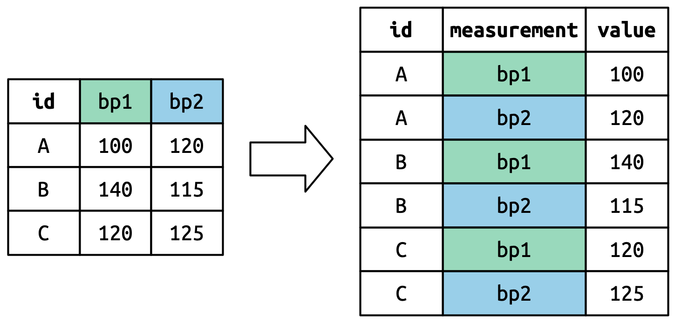
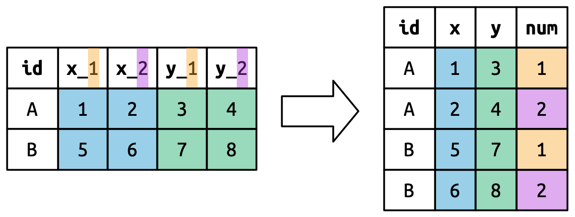
Data
Tidy Data
-each unique variable forms a column
-each observation forms a row
-each cell contains a single measurement
-statistical analysis/data manipulation is done in R

Slide 7
Columns include values
Color coding
Rows have variables with repeating names
Statistics and data
Manipulation performed on data sheet
Graph made on spreadsheet
Multiple Tabs of Analysis

Slide 8
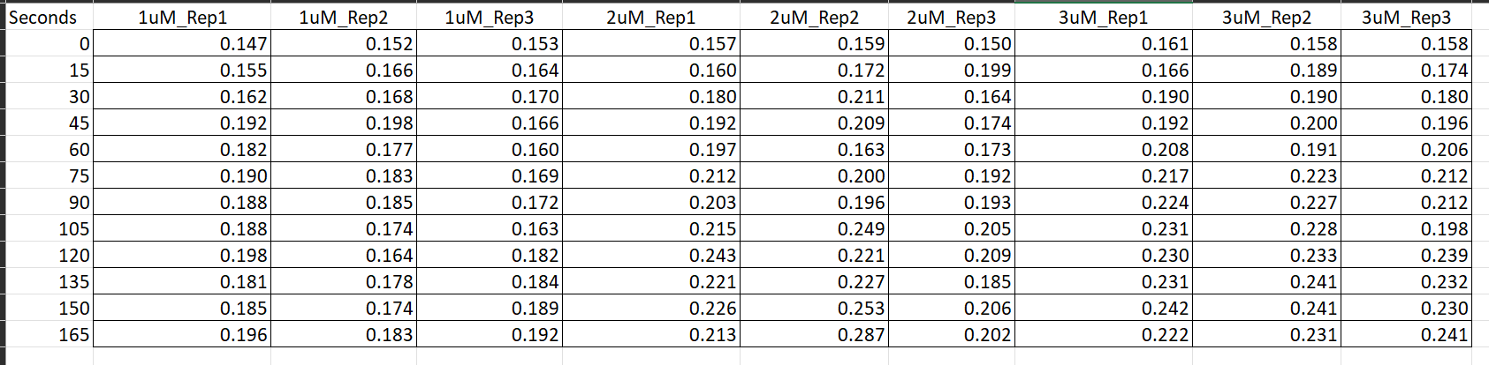
Is this tidy data?
New column can be made of replicates
New column can be made of concentrations

Slide 9
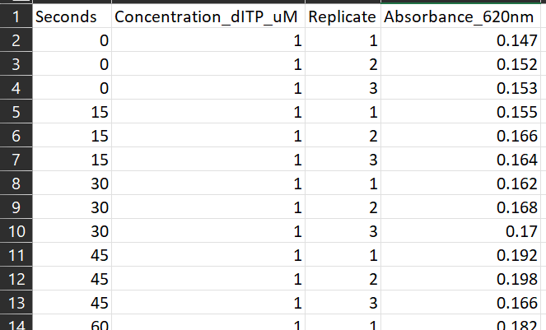

Time made into column with values
Unique column variable names

Slide 10
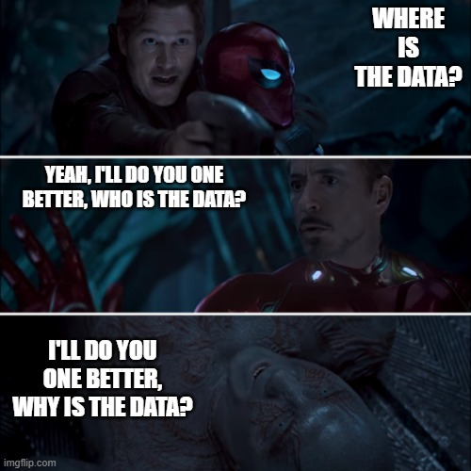

Data Sets (Code Chunk #2a and 2b)
data()
?iris
When you can make tidy data, access all the R data sets, and still not know how to graph

Slide 11
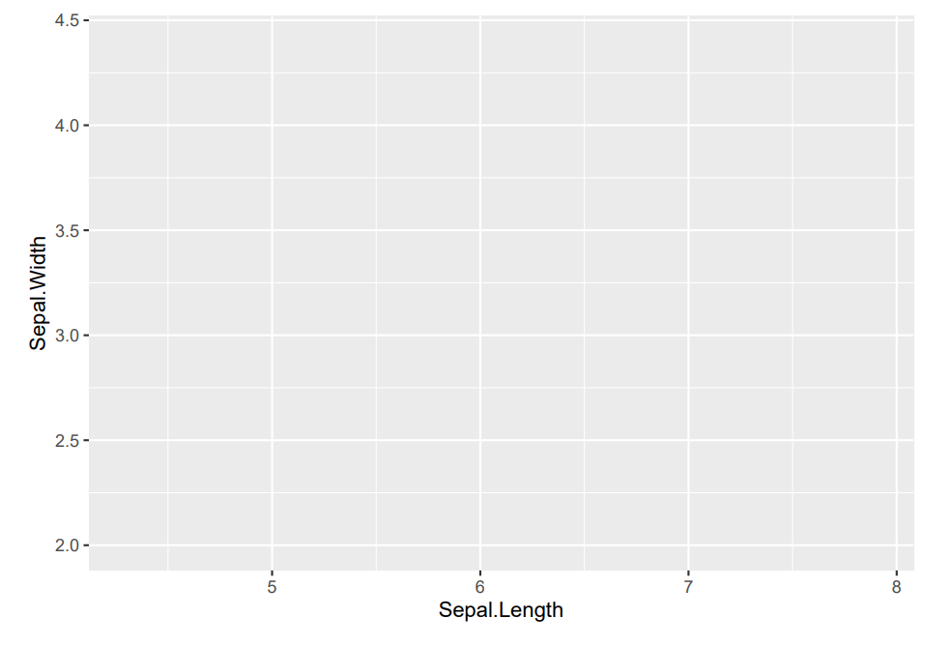

Aesthetics (Code Chunk 3 and 3b)
/Mapping
iris %>%
ggplot()
iris %>%
ggplot(aes(x = Sepal.Length, y = Sepal.Width))

Slide 12
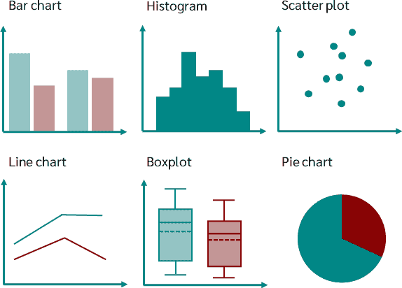
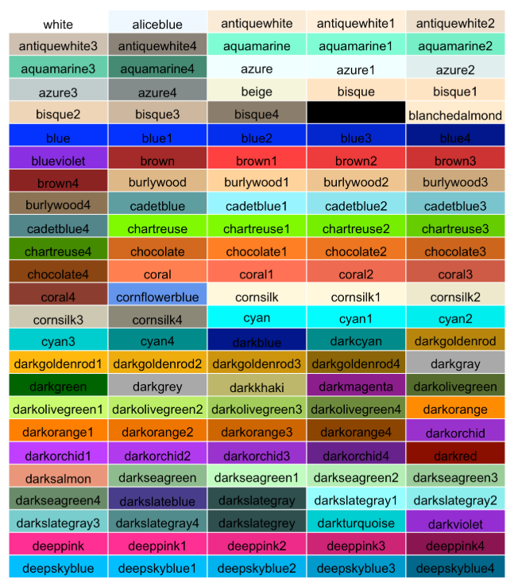
Geometries Code Chunk 4
ggplot(data=iris) +
mapping=aes(x = Sepal.Length, y = Sepal.Width)) +
geom_point()
iris %>%
ggplot(aes(x = Sepal.Length, y = Sepal.Width)) + geom_point()

Slide 13
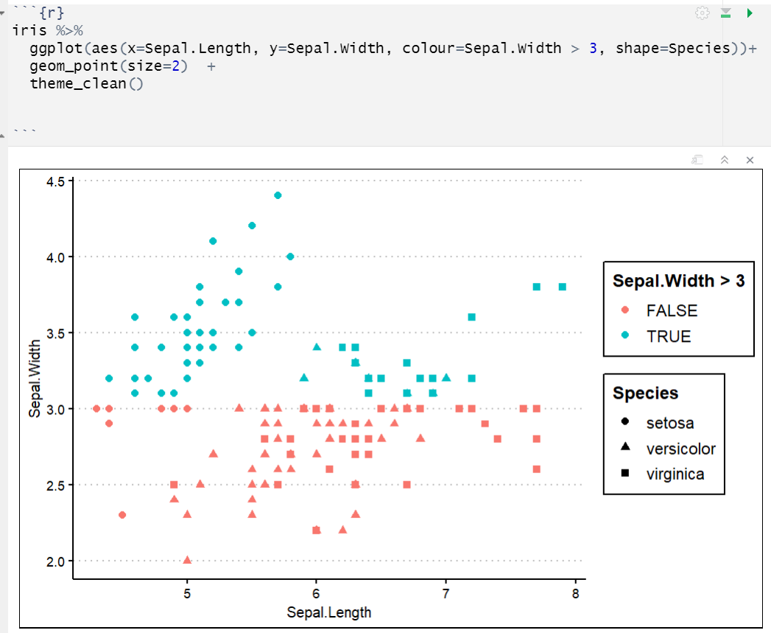
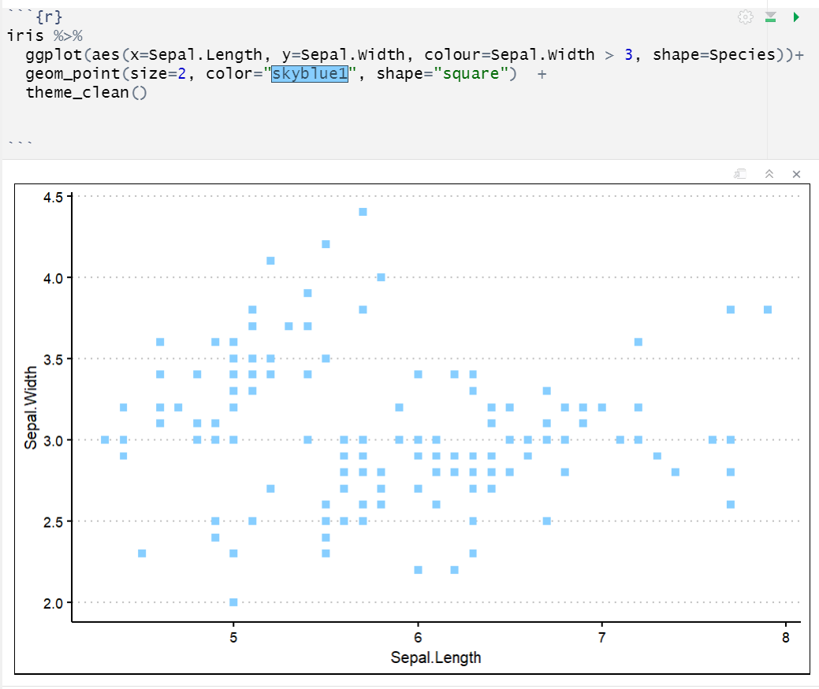
Back to Aesthetics (Code Chunk 5d)
AESTHETICS CHANGE DEPENDING ON GEOMETRY
GEOMETRY OVERRIDES MAPPING

Slide 14
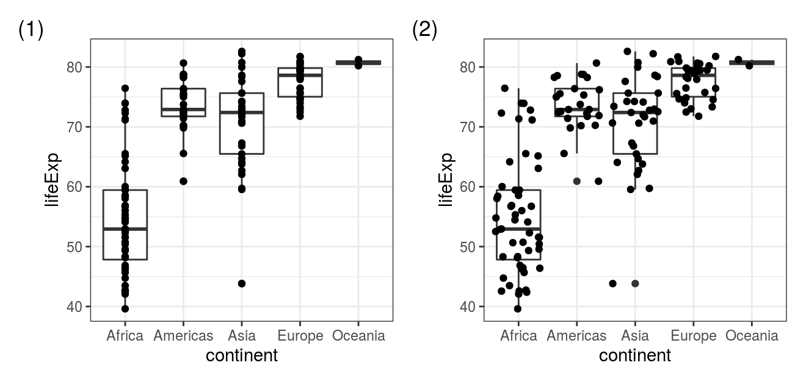

More Geometries, Multiple Geometries (Code Chunk 7)
Reviewer #3:
These boxplots are great, but I want to see the actual data points overlap

Slide 15
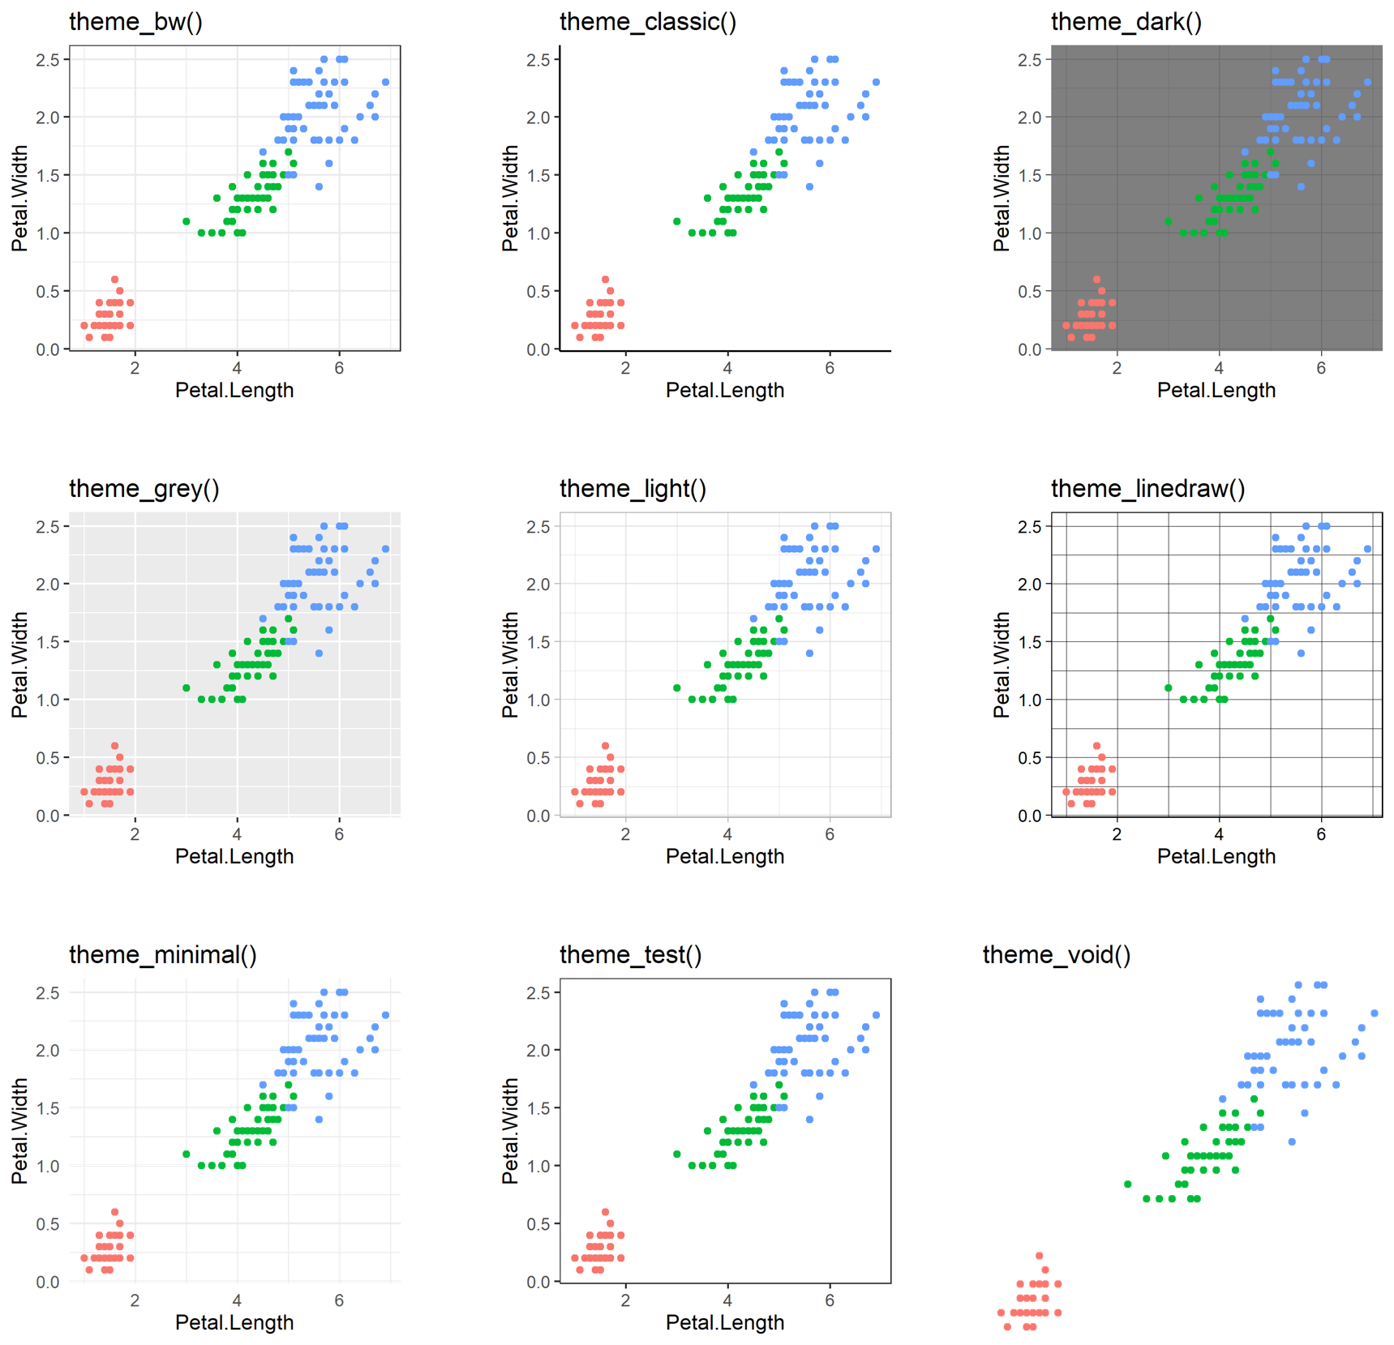
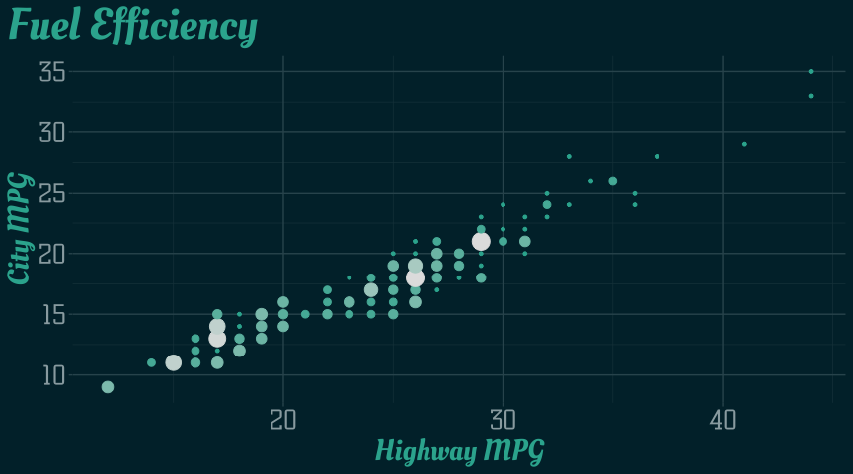
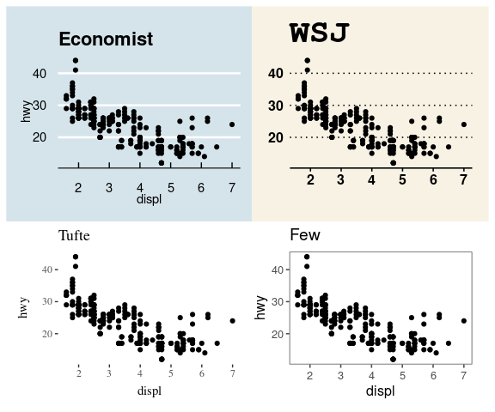
Themes
AKA the real aesthetics (Code Chunk 11)
Try making your own theme!
ggthemes

Slide 16

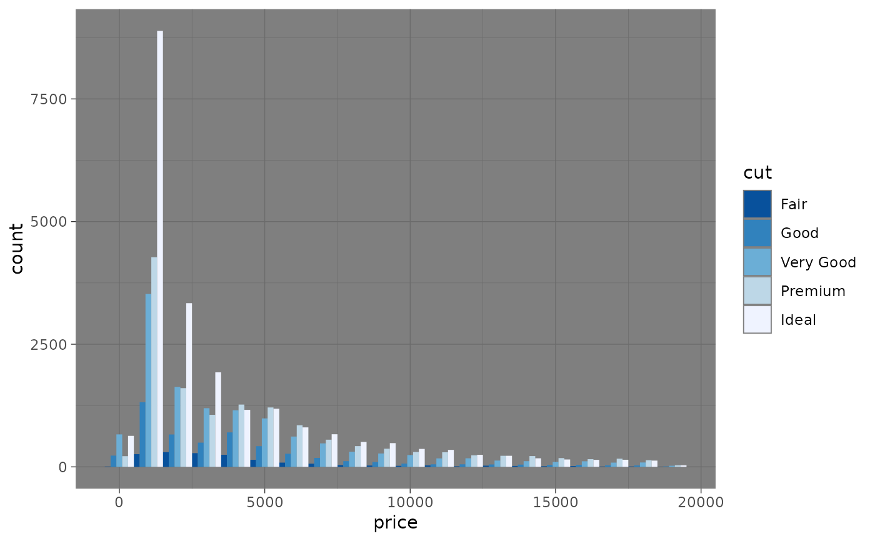
Introduction to ggPlot Day 2
Alex Alon
“Remember this is your graph; you get to make and break the data here”
-ggPlot
Don’t know how to use photoshop so here is Deadpool instead

Slide 17
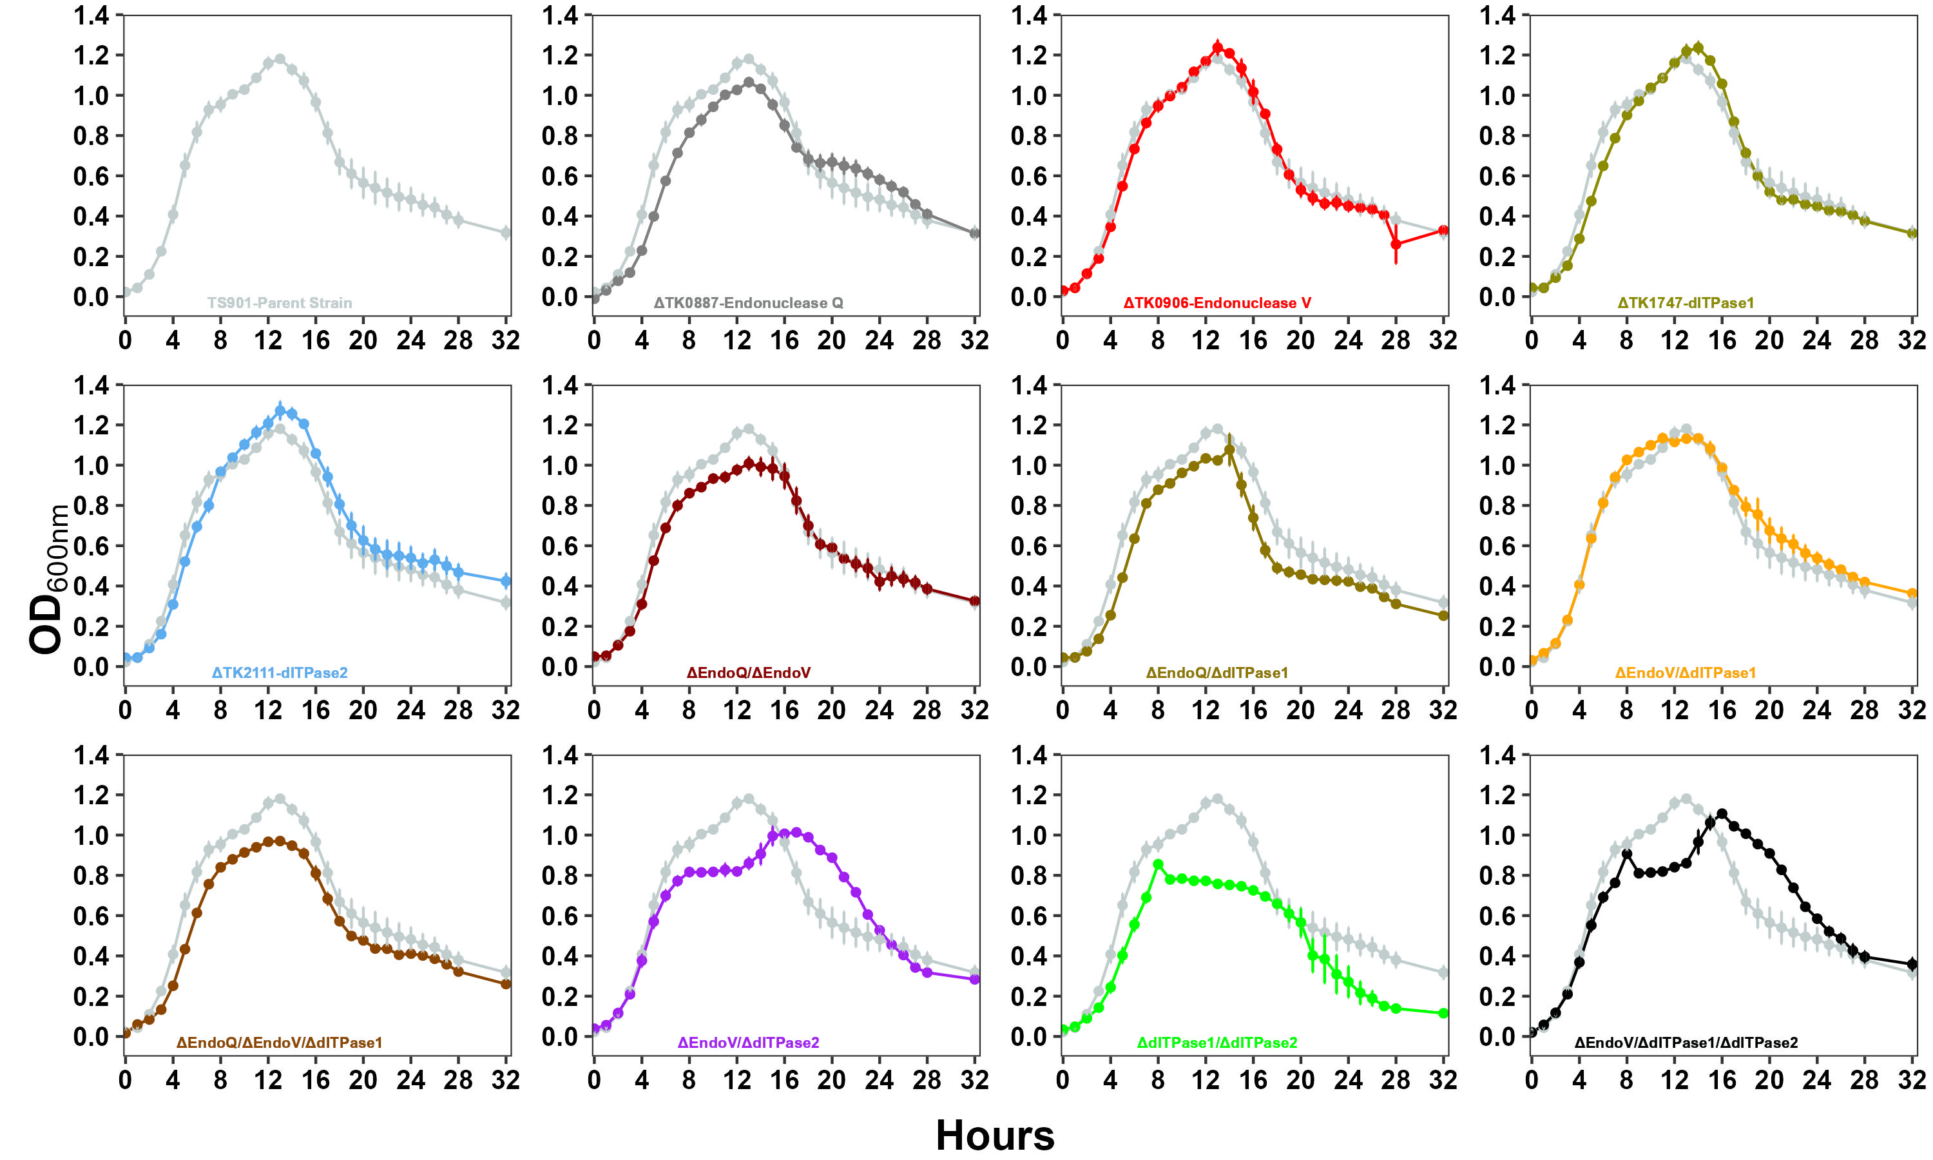
Building a Graph From Scratch
OD_{600 nm}

Slide 18
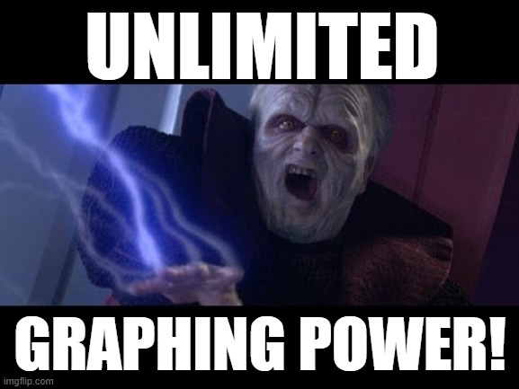
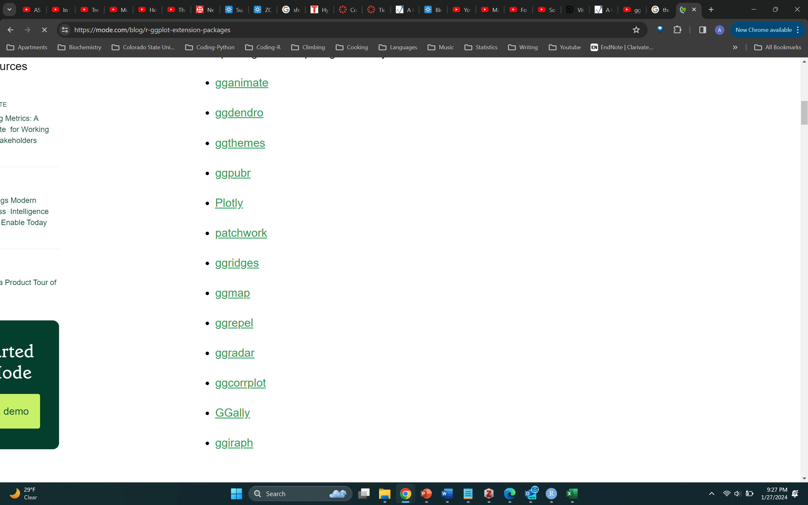
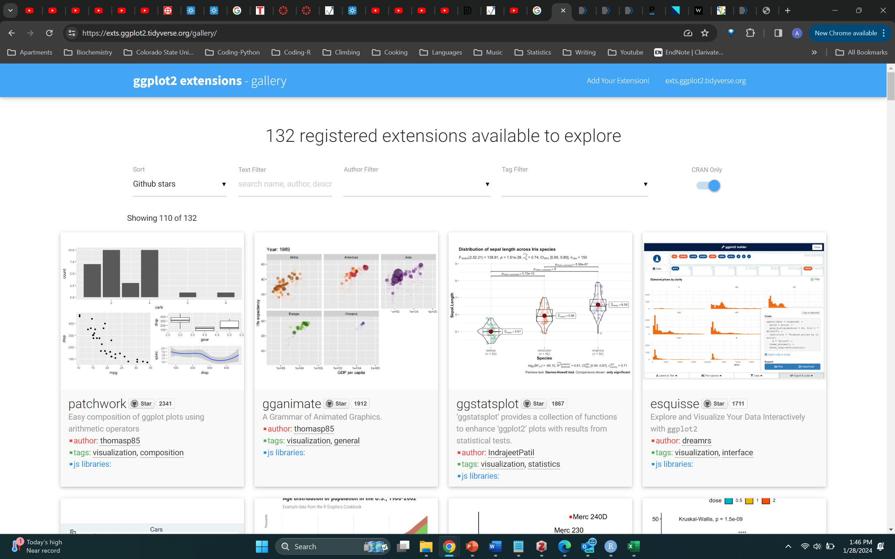
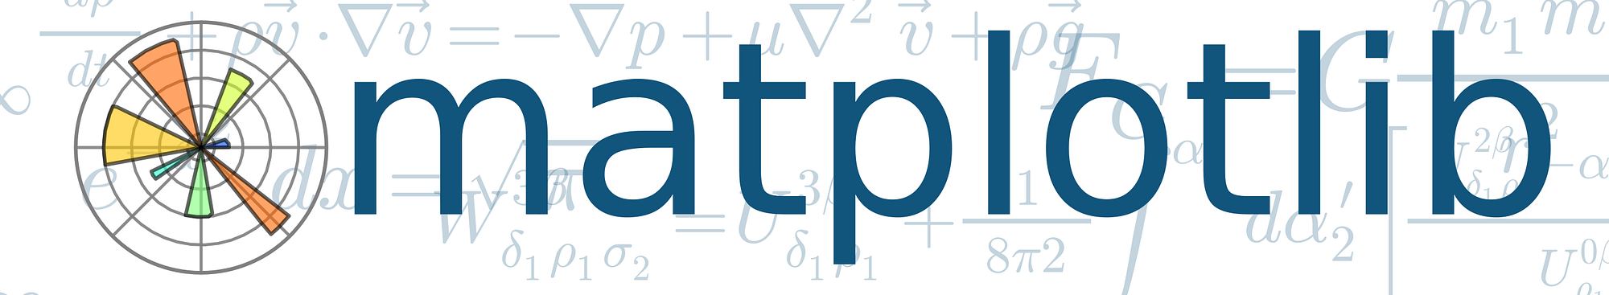
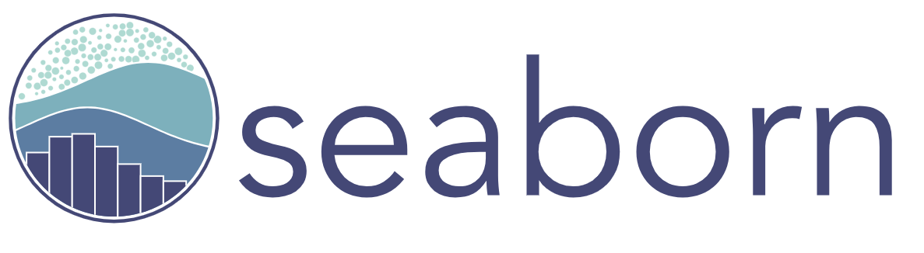
https://exts.ggplot2.tidyverse.org/gallery/
gridExtra
Better default resolution
More disk space
ggplot’s layered approach is simpler
Python’s programmatic approach promotes heavy customization
Can use R code and python code together (see reticulate and subprocess)

